Slide 1

Maze Generator and Solver
Ahmed Magdy (221001359)
Amr Hamouda (221001776)
Mohamed Goma (221001823)

Slide 2
Introduction
This project aims to generate and solve mazes using python and pygame.
Maze generation is performed using Depth-first search(DFS).
Maze solving is achieved using Breadth-first search(BFS) and A* algorithm.

Slide 3
Project Components
Maze Generation: Uses the Depth-First Search (DFS) algorithm.
Maze Solving: Utilizes Breadth-First Search (BFS) and A* algorithms.
Visualization: Implements Pygame to visualize the maze generation and solving process.

Slide 4
Maze Generation Algorithm (DFS):
Set up a grid of cells where each cell starts as a wall.
Begin at a starting cell, mark it as visited, and use a stack to keep track of the path.
Randomly choose unvisited neighboring cells, remove walls, and mark cells as visited.
Backtrack using the stack when no unvisited neighbors remain.
Continue until all possible paths are explored.

Slide 5
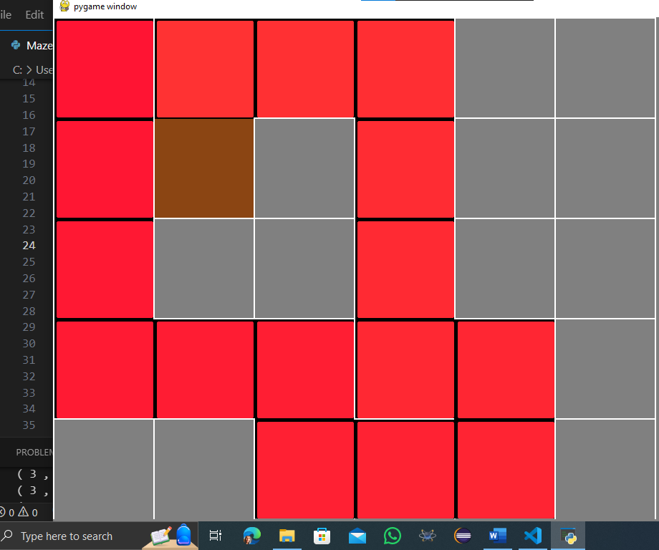
Snapshot for Generating the maze:

Slide 6

Breadth-First Search (BFS):
It Explores all neighbors at the present depth level before moving on to nodes at the next depth level.
It initializes a deque (double-ended queue) with the start cell and a dictionary ‘came_from’ to keep track of the path.
Highlights the path from the start cell to the end cell.

Slide 7

Snapshots for Solving Maze by (BFS):

Slide 8
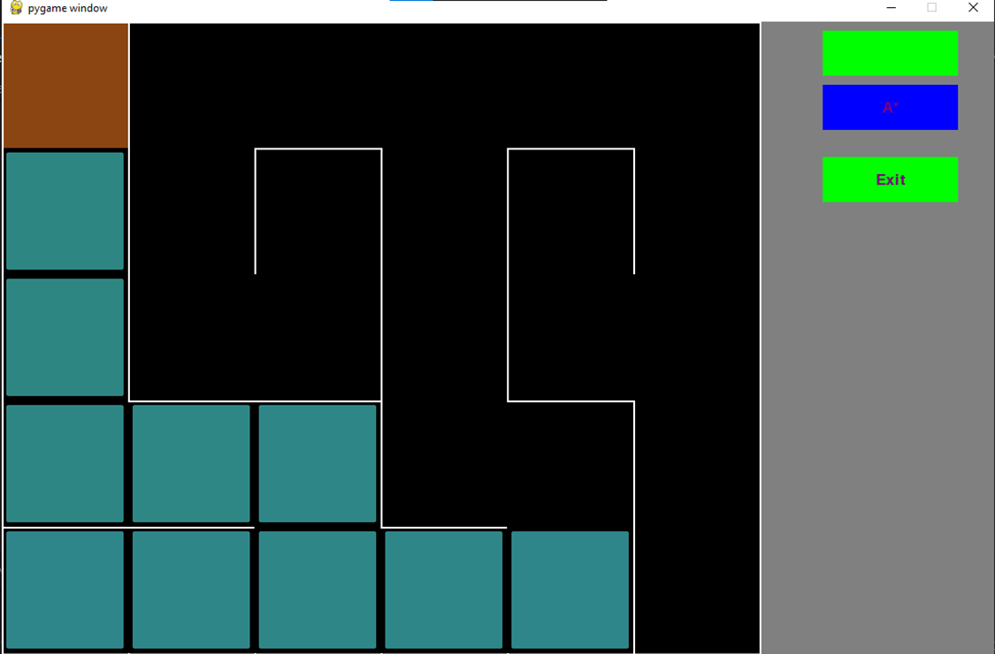

Slide 9
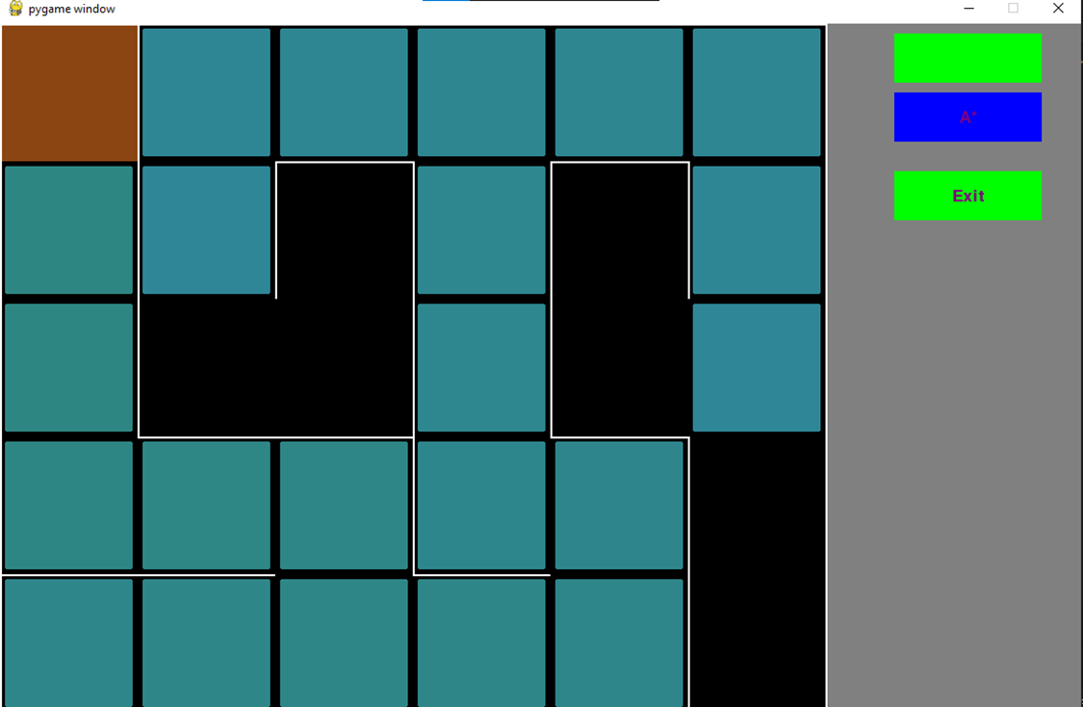

Slide 10
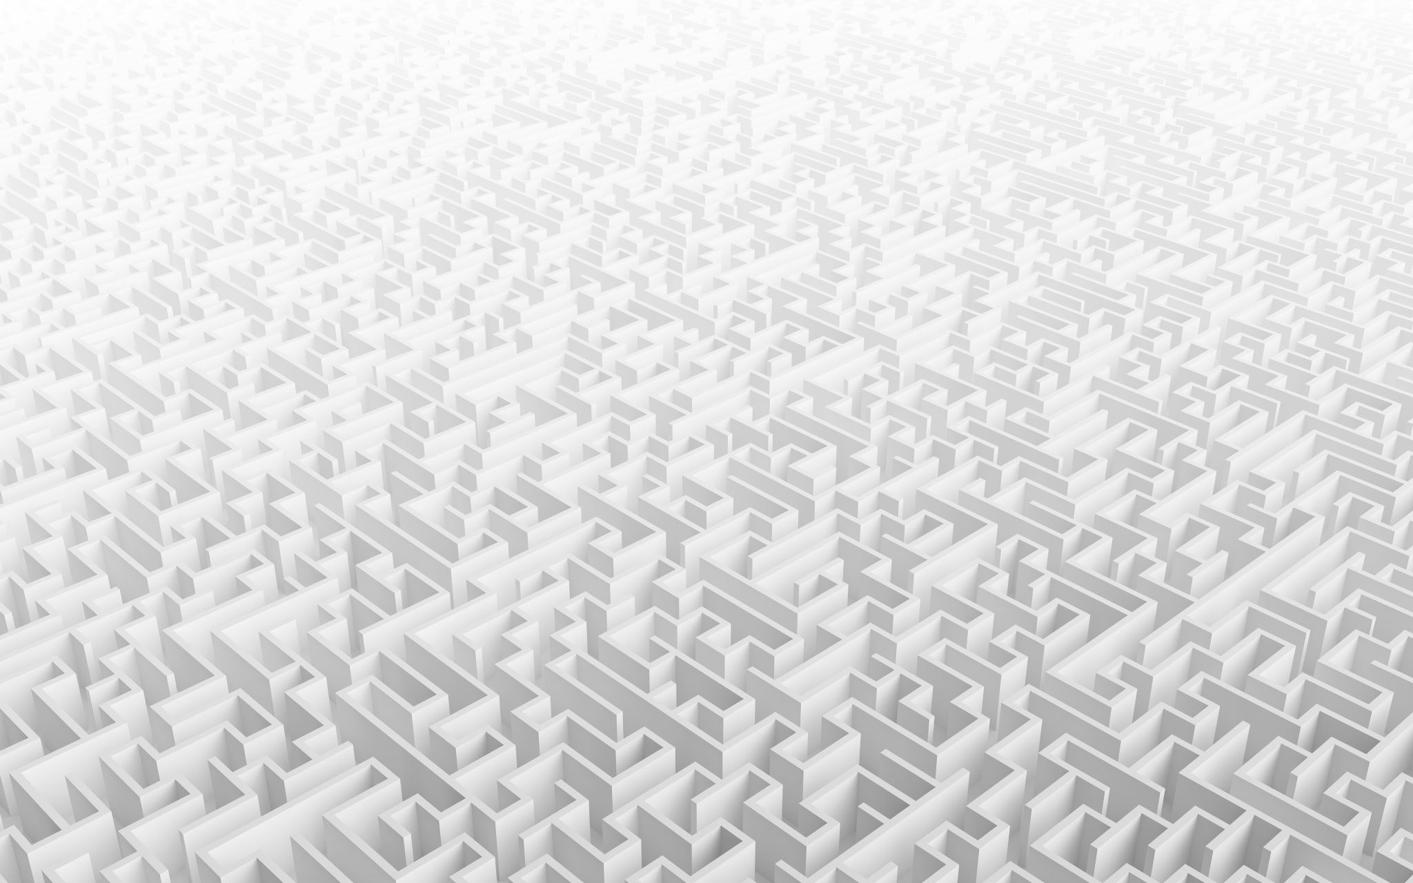
Snapshot for Maze Solved by (BFS):

Slide 11
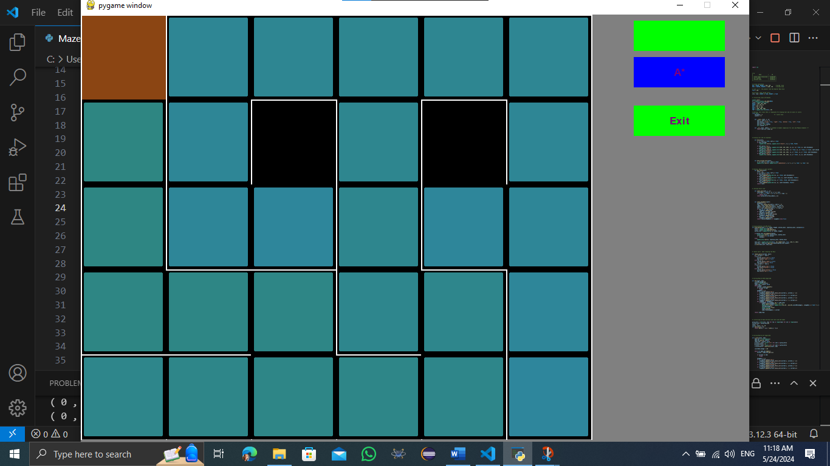

Slide 12
Maze Generation Algorithm(A*):
It combines features of uniform-cost search and pure heuristic search to find the lowest cost path.
Uses the Manhattan distance as the heuristic function.

Slide 13
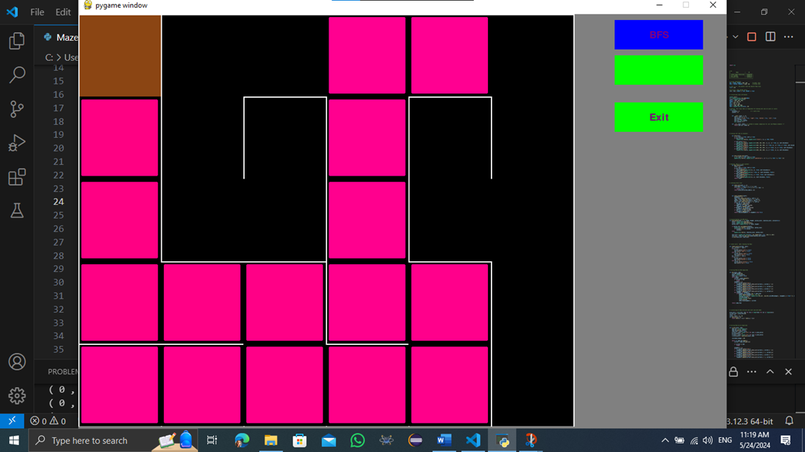
Snapshot for Solving Maze by (A*):

Slide 14
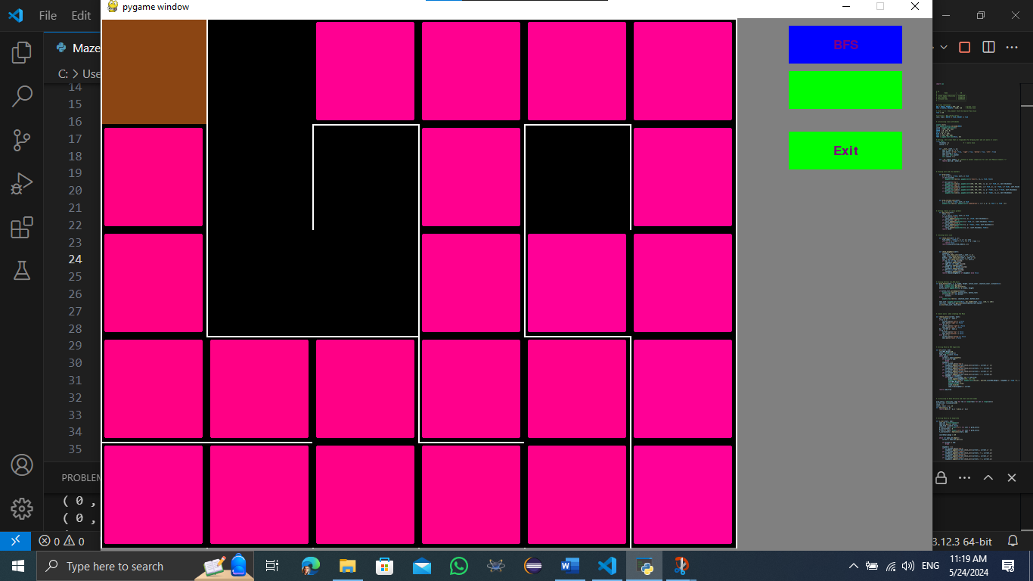
Snapshot for Maze Solved by (A*):

Slide 15
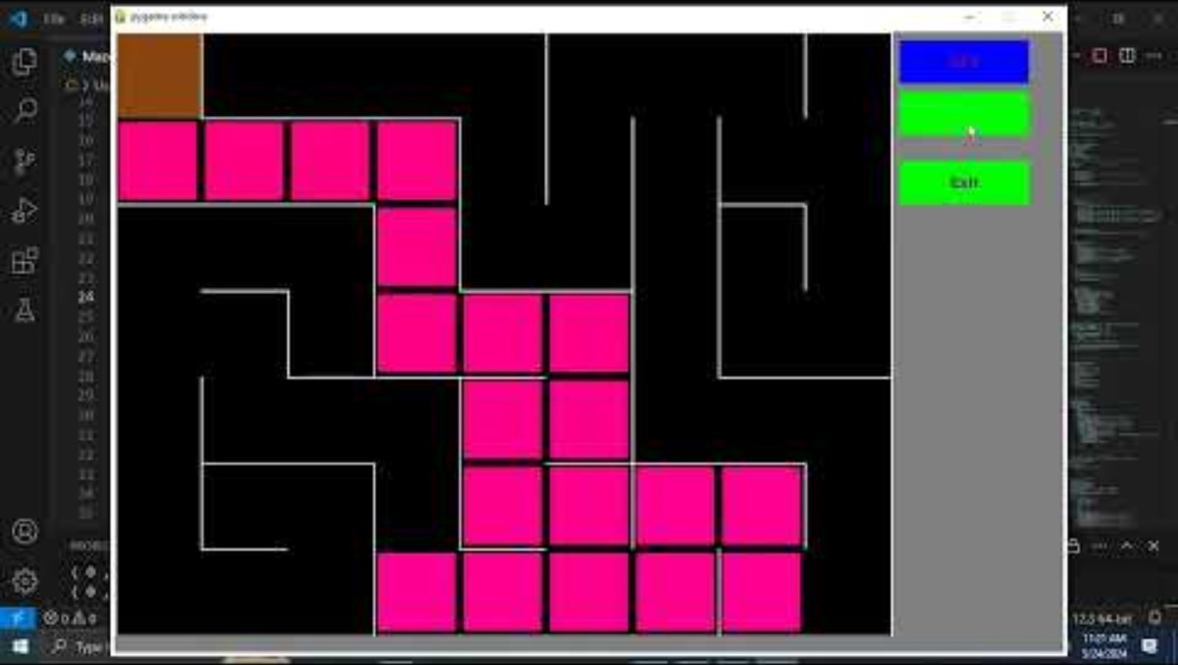
Video for our Program:

Slide 16

Thank You

